Slide 1
Leeds Beckett University
Cloud Computing Development
Dr Anatoliy Gorbenko
E-mail: A.Gorbenko@leedsbeckett.ac.uk Office: CAE118
Kiran Voderhobli
E-mail: k.voderhobli@leedsbeckett.ac.uk Office: CAE228

Slide 2
Cloud Computing Development
Lecture: Virtualization technologies
Anatoliy Gorbenko
Kiran Voderhobli

Slide 3
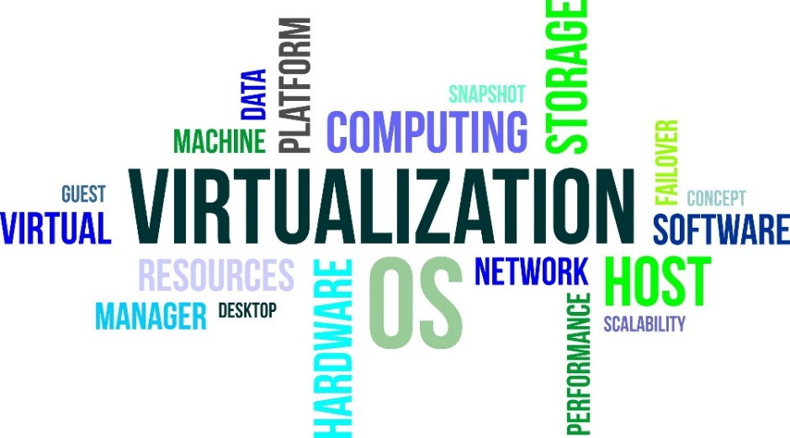
Lecture Agenda
Definition
Classification
Architecture
Hypervisor overview
Virtualization

Slide 4
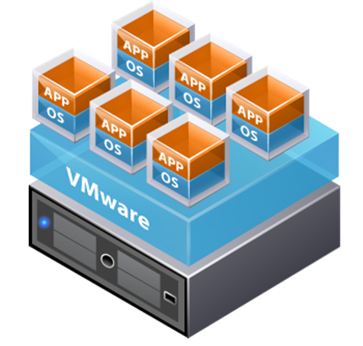
Virtualization
Definitions

Slide 5
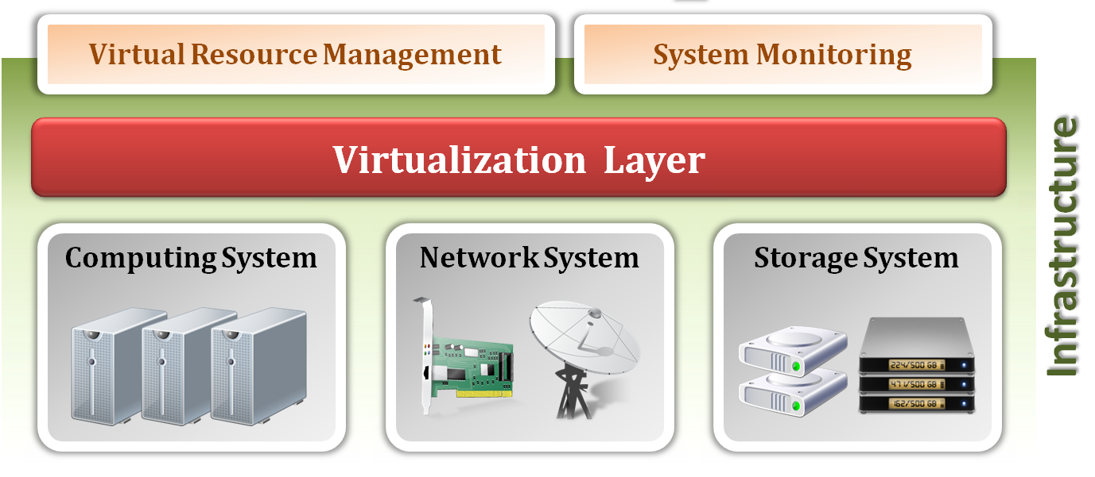
IaaS and Virtualization
Infrastructure as a Service (IaaS) delivers computer infrastructure for cloud user, typically a platform virtualization environment as a service.
Virtualization is an enabling technique to provide an abstraction of logical resources away from underlying physical resources.

Slide 6
Virtualization Definition
What is virtualization ?
Virtualization is the creation of a virtual (rather than physical) version of something, such as an operating system, a server, a storage device or network resources.
It hides the physical characteristics of a resource from users, instead showing another abstract resource.
But, where does virtualization come from ?
Virtualization is NOT a new idea of computer science.
Virtualization concept comes from the component abstraction of system design, and it has been adapted in many system level.

Slide 7
System Abstraction
Computer systems are built on levels of abstraction.
Higher level of abstraction hide details at lower levels.
Designer of each abstraction level make use of the functions supported from its lower level, and provide another abstraction to its higher one.
Example: files are an abstraction of a disk

Slide 8
System Abstraction
For OS developers, a machine is defined by ISA (Instruction Set Architecture).
This is the major division between hardware and software.
Examples :
X86
ARM
MIPS

Slide 9
OS-level Abstraction
For compiler or library developers, a machine is defined by ABI (Application Binary Interface).
This define the basic OS interface which may be used by libraries or user.
Examples :
User ISA
OS system call

Slide 10
Library level abstraction
For application developers, a machine is defined by API (Application Programming Interface).
This abstraction provides the well-rounded functionalities.
Examples :
User ISA
Standard C library
Graphical library

Slide 11
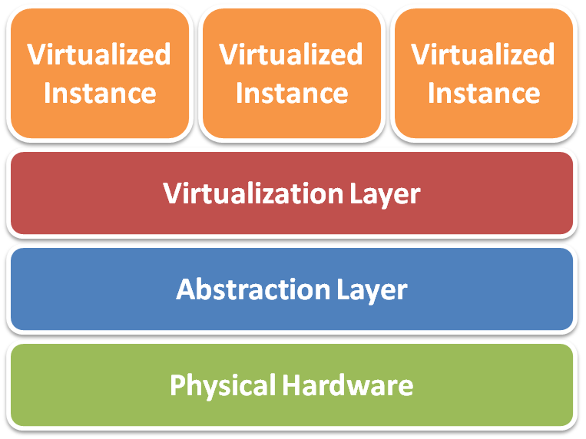
Virtualization Architecture
The concept of virtualization is everywhere !!
In IaaS, we focus the virtualization granularity at each physical HW device.
Different physical resources: Server, Storage and Network
Virtualization implementation level:
Virtualized instance
Software virtualized hardware instance
Virtualization layer
Software virtualization implementation
Abstraction layer
Various types of hardware access interface
Physical hardware
Various types of infrastructure resources

Slide 12
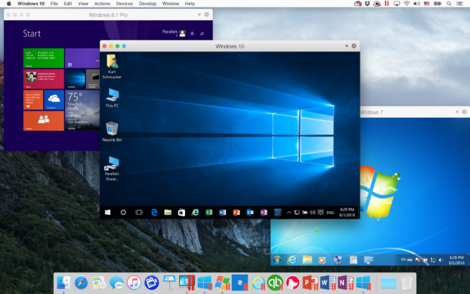
Virtual Machine
VM is a software implementation of a machine (i.e. a computer) that executes programs like a real machine.
Terminology :
Host (Target)
The primary environment where will be the target of virtualization.
Guest (Source)
The virtualized environment where will be the source of virtualization.

Slide 13
Emulation vs. Virtualization
Emulation technique
Simulate an independent environment where guest ISA and host ISA are different.
Example:
Emulate x86 architecture on ARM platform.
Virtualization technique
Simulate an independent environment where guest ISA and host ISA are the same.
Example:
Virtualize x86 architecture to multiple instances.

Slide 14
Virtualization
Process-level
Desktop-level
OS-level
HW-level
Classification

Slide 15
Process Virtualization
Usually execute guest applications with an ISA different from host (e.g. Java VM, Microsoft CLI)

Slide 16
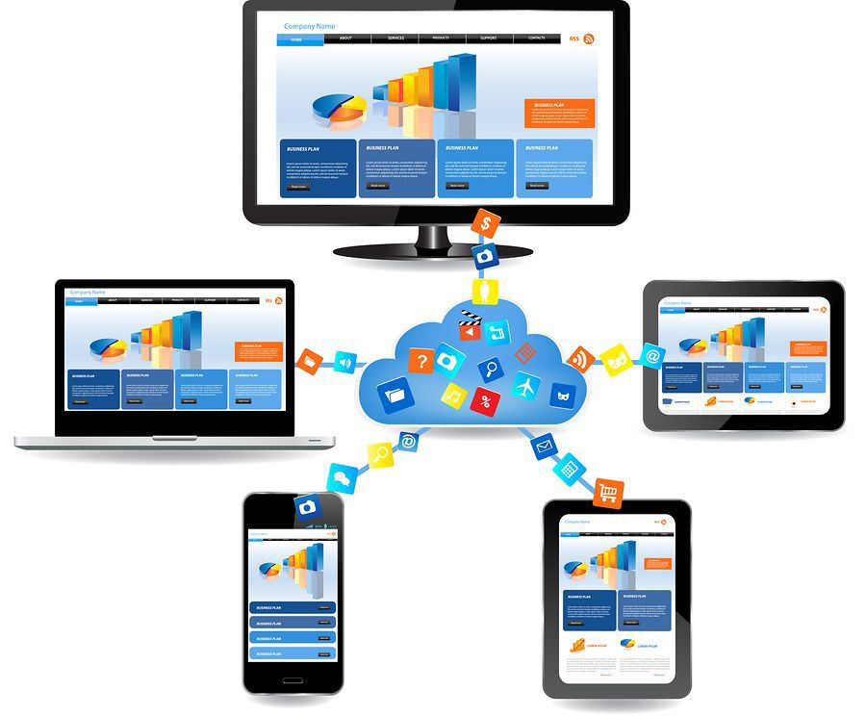
Remote Desktop Virtualization
is software technology that separates the desktop environment and application software from the physical client device that is used to access it
Application execution takes place on a remote operating system which communicates with the local client device over a network using a remote display protocol (e.g. VDI, RDP, Team Viewer)
All applications and data used remain on the remote system with only display, keyboard, and mouse information communicated with the local client device
Clients: conventional PCs/laptops, thin client devices, tablets, smartphones.

Slide 17
HW-level Virtualization
Provide the entire operating system on same or different host ISA
Constructed at ISA level
e.g. XEN, KVM, VMWare (x86 virtualization software)

Slide 18
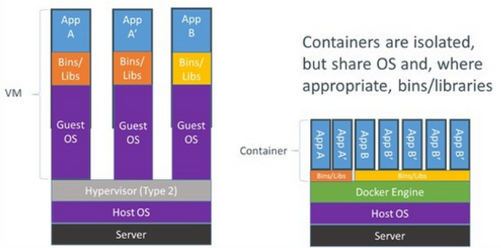
OS-level Virtualization
Containerization (e.g. Linux containers - Docker)

Slide 19
Hypervisors
Type 1
Type 2
Full virtualization
Para virtualization
Classification

Slide 20
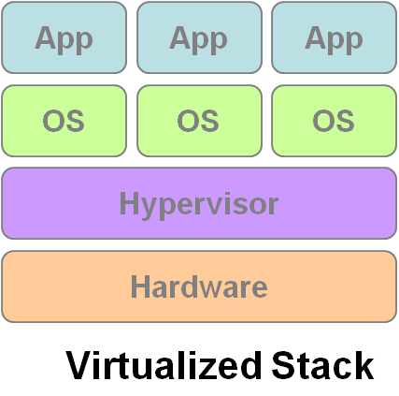
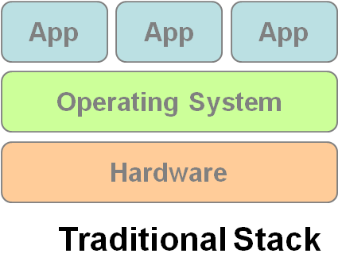
Hypervisor (System Virtual Machine)
What’s Virtual Machine Monitor (VMM)?
VMM or Hypervisor is the software layer providing the virtualization.
System architecture :
VM1
VM2
VM3

Slide 21
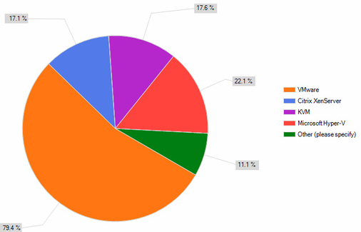
Hypervisor Market Share

Slide 22
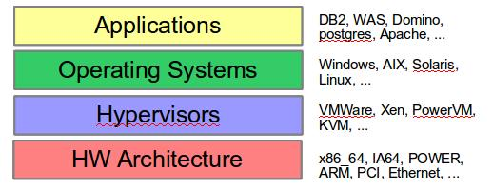
Virtualization Types
Virtualization Types:
Type 1 – Bare metal/Native
VMMs run directly on the host's hardware as a HW control and guest operating system monitor (Xen, VMware ESX/ESXi).
Type 2 – Hosted/Embedded
VMMs are software applications running within a conventional operating system (e.g. KVM, VMware Workstation, VMware Player, VirtualBox, QEMU).

Slide 23
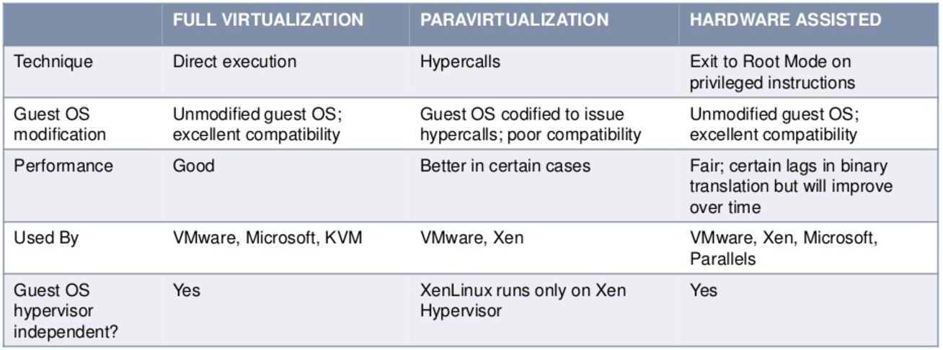
Virtualization Technique
Full-Virtualization: VMM simulates hardware to allow an unmodified guest OS.
Para-Virtualization: VMM does not necessarily simulate hardware, but instead offers a special API that can only be used by the modified guest OS.
HW assisted: enables effective full virtualization making use CPU capabilities (Inter VT-x, AMD-V).

Slide 24
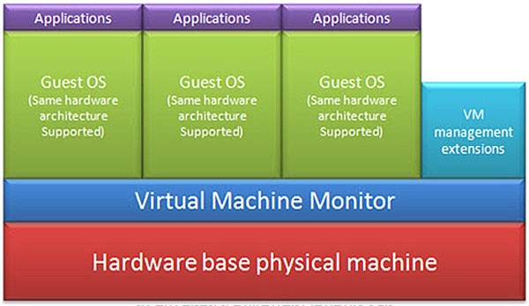
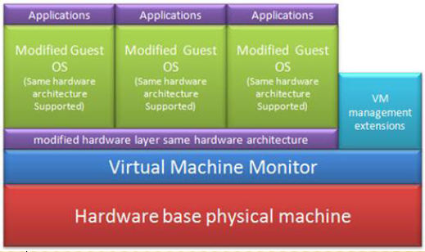
Virtualization Types
Full-Virtualization
Para-Virtualization
Pros | Light weight and high performance
Cons | Require modification of guest OS
Pros | Need not to modify guest OS
Cons | Significant performance hit

Slide 25
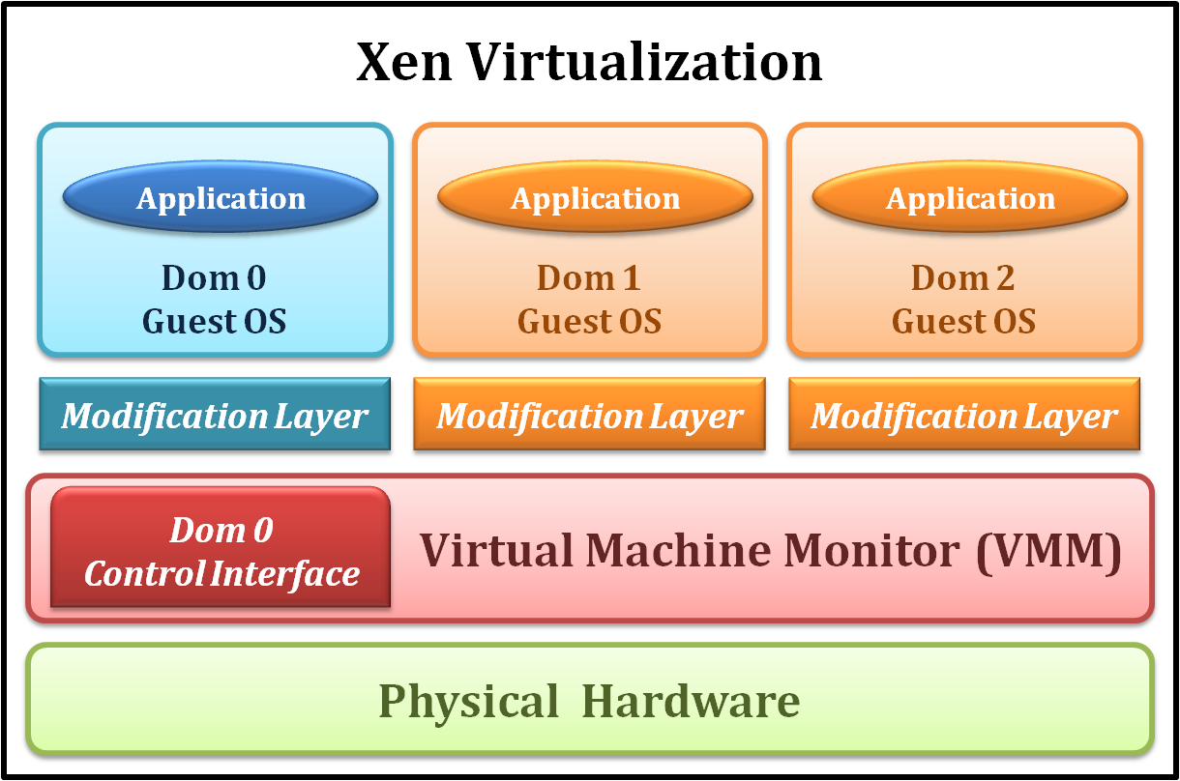
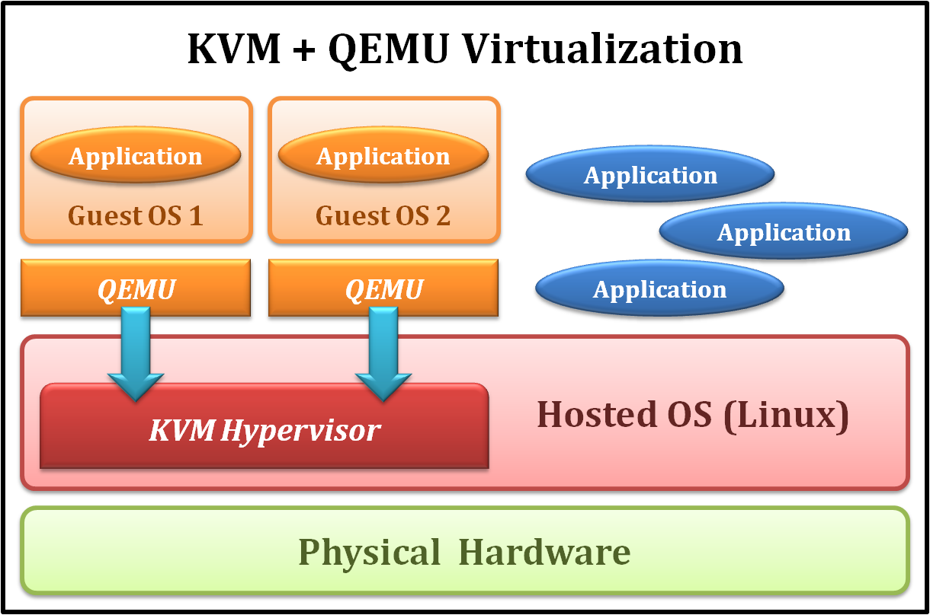
VM Examples
Xen
Type 1 Virtualization
Para-Virtualization
KVM
Type 2 Virtualization
Full/Para Virtualization
VMware ESXi
Type 1 Virtualization
Full/Para Virtualization

Slide 26
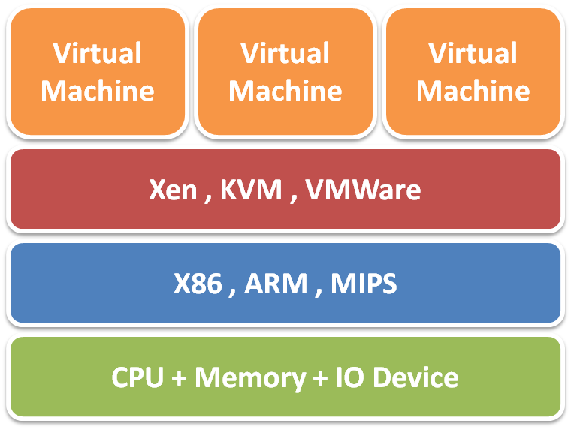
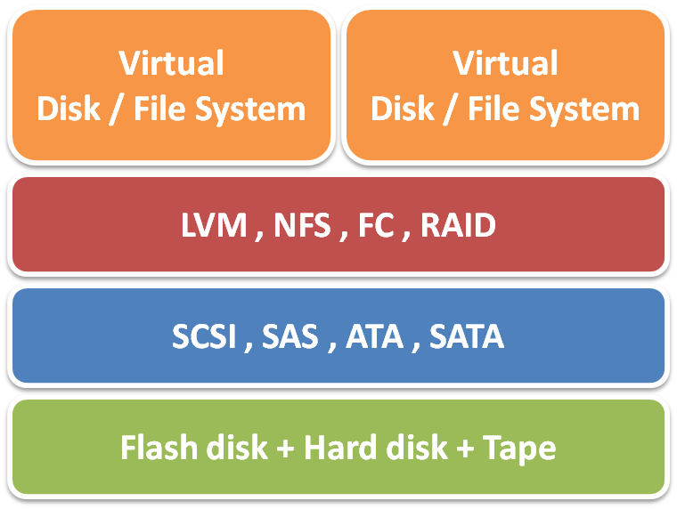
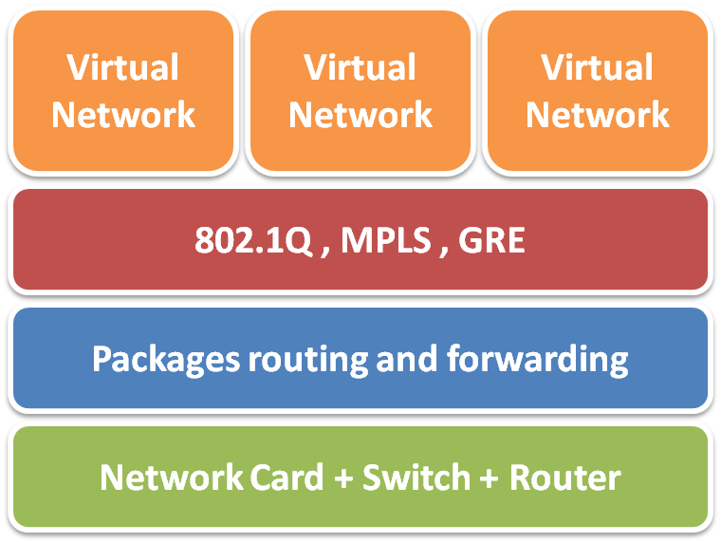
Virtualized Data Centers
Server Virtualization
Network Virtualization
Storage Virtualization

